Slide 1


Mobile Programming Course Fall 2021 Mohamad ChamanMotlagh Amirhosseir Hedielou Moein NasrKhademli Course lecturer: Dr. Sajad Shirali-Shahreza CE Department, Amirkabir University of Technology
3D illustrator
First Preview

Slide 2
TABLE OF CONTENTS
1.
2.
3.
Motive & Purpose
Remebring the main idea
Implemented Sections
What has been done so far
Demo
A short demo of our work

Slide 3
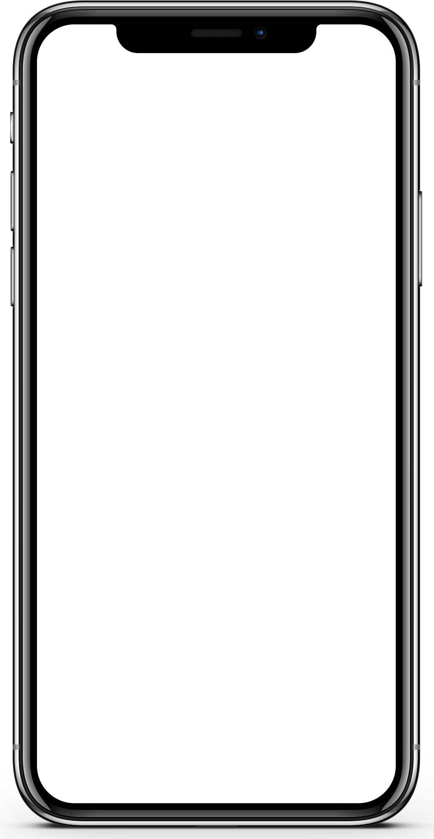
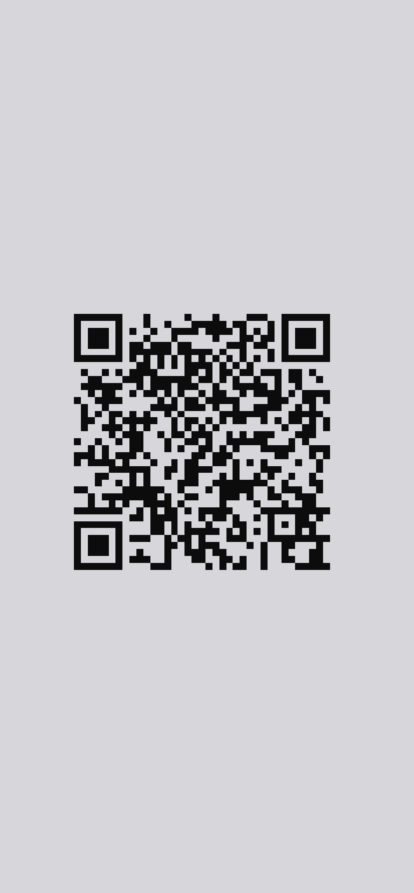

Simplified Workflow
Authentication
Search
Process and Send

Slide 4
Implemented Sections
Overall flow of the Application
First page of the app
QR scanner Activity
Model Viewer Activity
Structure
Coloring and Styles
Dark/Light mode
Activity change
Structure
Functionality

Slide 5
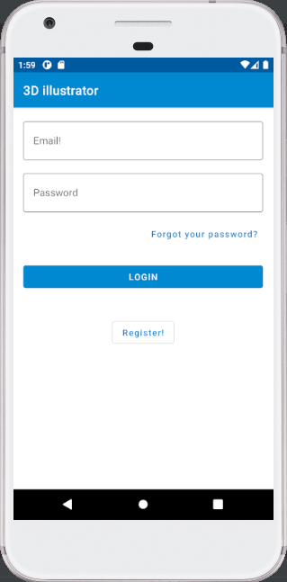
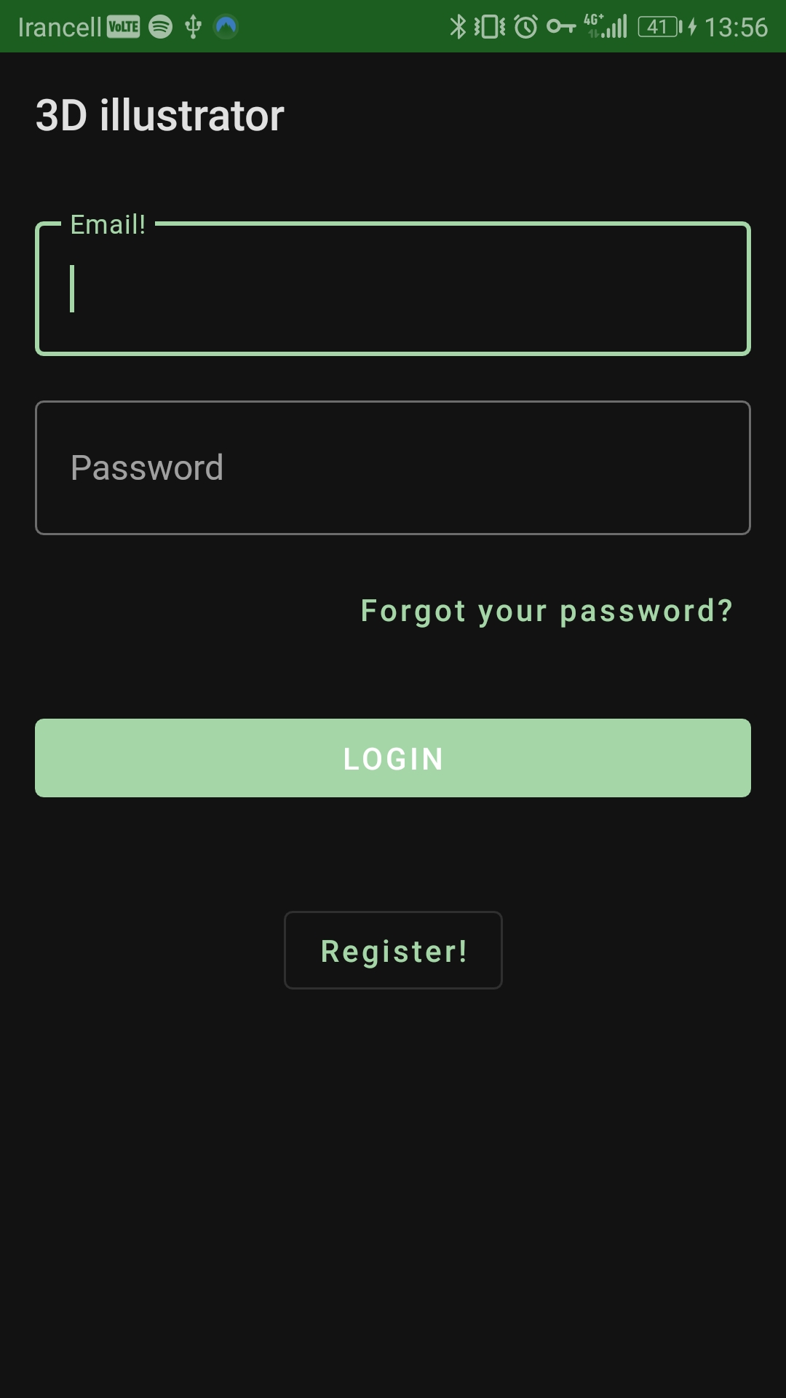
Demo

Slide 6
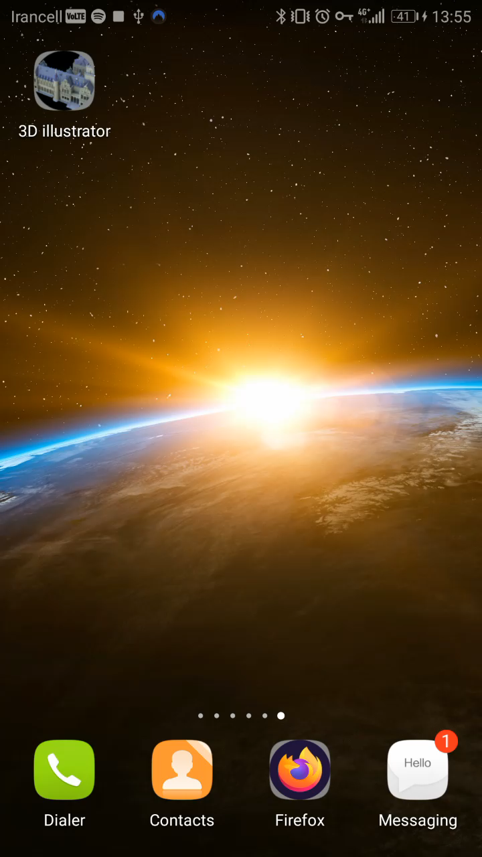
Demo

Slide 7
THANKS!
DO YOU HAVE ANY QUESTION?

